Slide 1

Machine Learning Optimization for AMES Mutagenicity Dataset
Team members: Isaac, Miko, Xiao, Jason

Slide 2
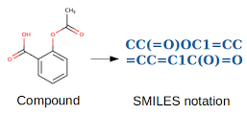


Introduction to the AMES Dataset
Definition: The AMES dataset evaluates mutagenicity of chemical compounds, which refers to their potential to cause genetic mutations, often linked to carcinogenicity.
SMILES: Chemical structures are represented as Simplified Molecular Input Line Entry System (SMILES) strings, a compact way to encode molecular structures.
Mutagenicity: Binary classification—Mutagenic (1) or Non-Mutagenic (0).
Purpose:
Widely used in computational toxicology and cheminformatics to predict chemical safety.
Supports the development of models that reduce reliance on animal testing.
Applications:
Toxicity prediction.
Feature engineering in drug discovery.
Aspirin

Slide 3
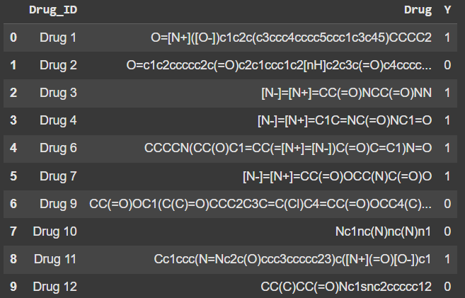
Key Characteristics of the Dataset
Dataset Overview:
Dataset Size: 7,255 drugs.
Train: 70%
Validation: 20%
Test: 10%
Input Features: Represented as SMILES strings, encoding chemical structures.
Dataset Distribution:
55%: mutagenic (1)
45%: non-mutagenic (0)
Dataset Example:

Slide 4
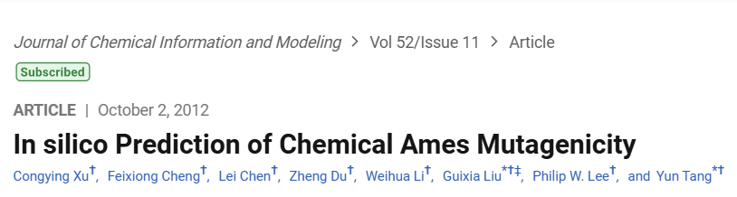
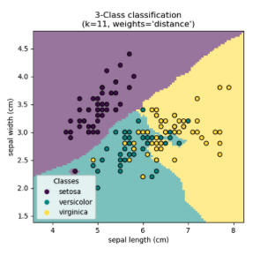
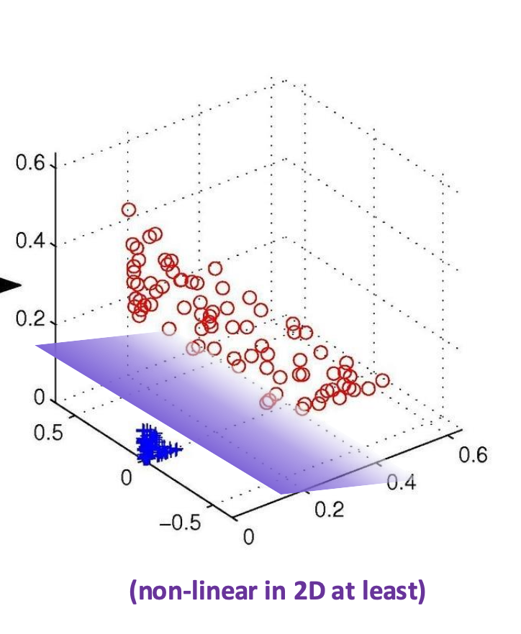
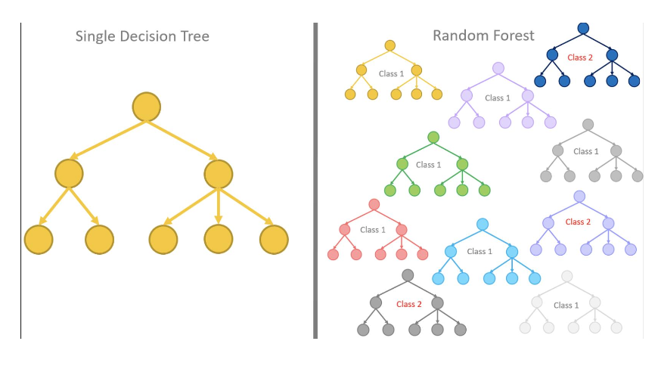
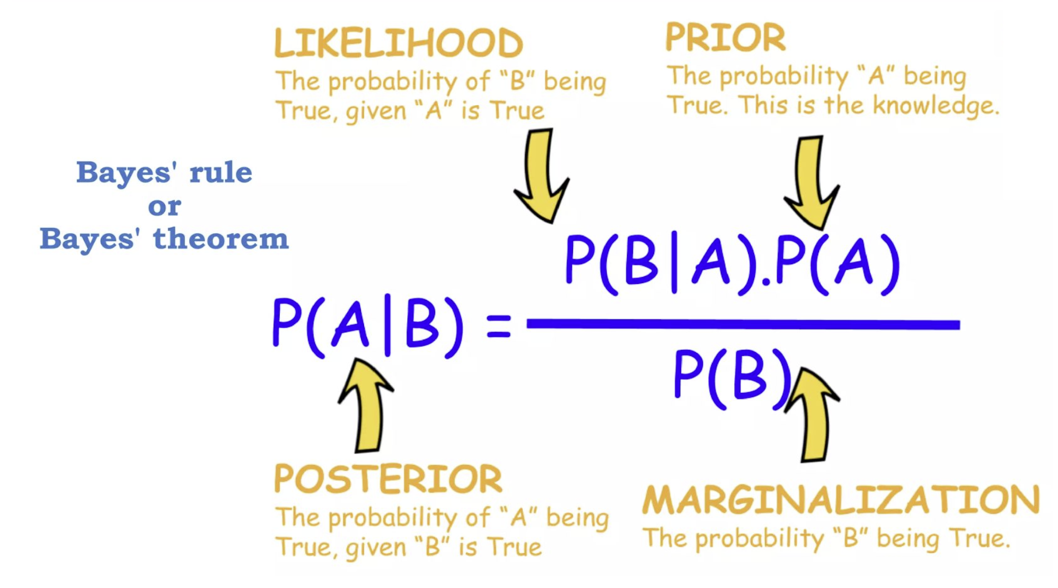
Reference Paper - Model Selection
Artificial Neural Network
K-nearest neighbors (kNN)
Support Vector Machine (SVM)
Naive Bayes
Decision Tree
SVM image adapted from: SVMs Lecture. Brenda Miao (UCSF) sourced from https://towardsdatascience.com/
Bayes Theorem Slide from Probability and Basian! Lecture. Harry Sun (UCSF)
KNN image from https://scikit-learn.org/1.5/modules/neighbors.html
Image from Decision Trees, Random Forests, and Ensemble Methods. Brendia Miao (UCSF)

Slide 5
Methodology Workflow
1. AUC Class Results
2. Feature Importance
FpDensityMorgan1
AMES Mutagenicity
7,255 drugs
(SMILES Strings)
RDKit Descriptor Package
FpDensityMorgan2
FpDensityMorgan3
Random Forest Classifier
Exact Molecular Weight
Heavy Atom Count

Slide 6
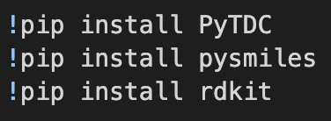
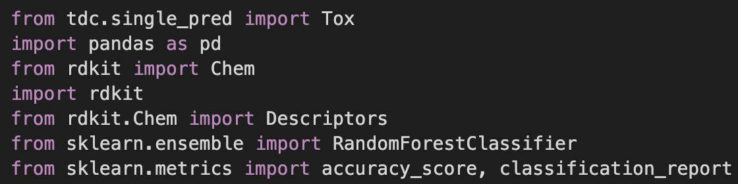
Methodology (continued)
Packages for data manipulation and model creation:
Feature engineering, in its simplest form, is the process of selecting, transforming, or creating new features from already existing data to improve the performance of ML models.
Features Used: Morgan Radius (max 3), molecular weight, heavy atom count
Modification of features were not conducted.
Feature selection was done so to capture electrophilic components, heavy electrophilic atoms, and molecular weight to infer DNA access.

Slide 7
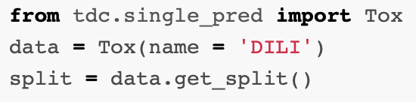
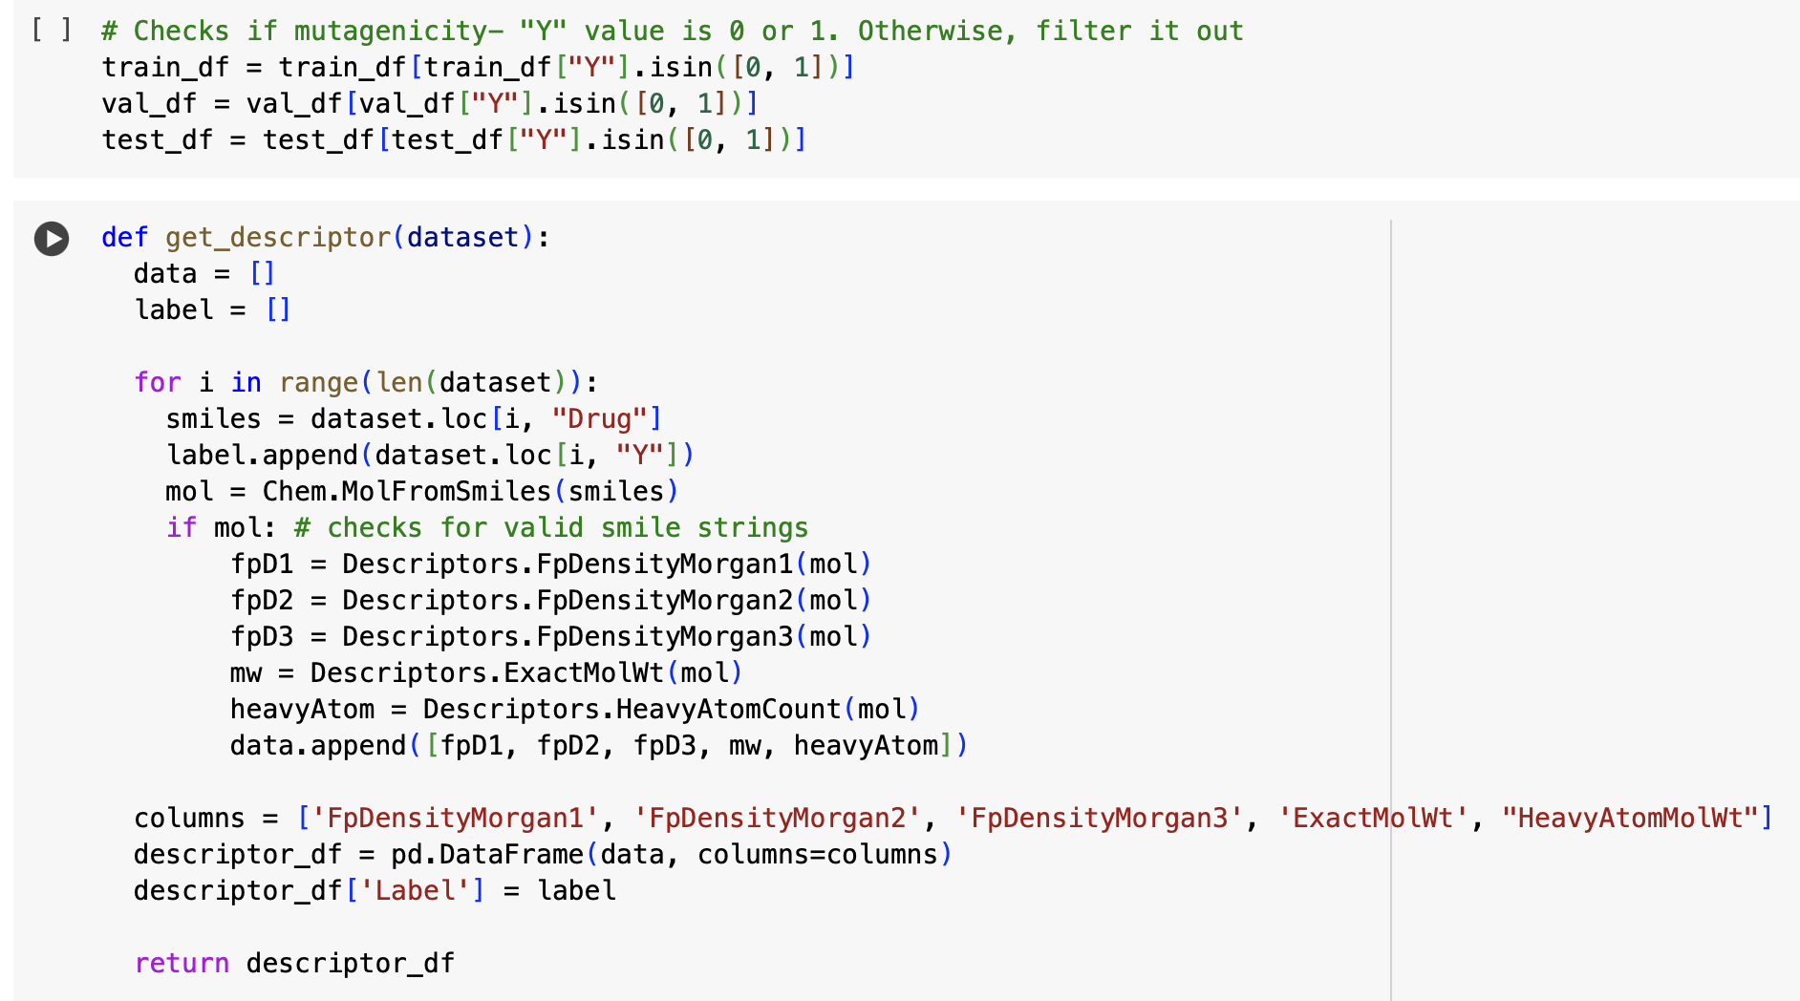
Data Filtering with RD_Kit RFC
Import the dataset, in a split setting by default
Validate the Y(mutagenicity) column
Validate the SMILES strings, if pass, a list of feature data will be displayed

Slide 8
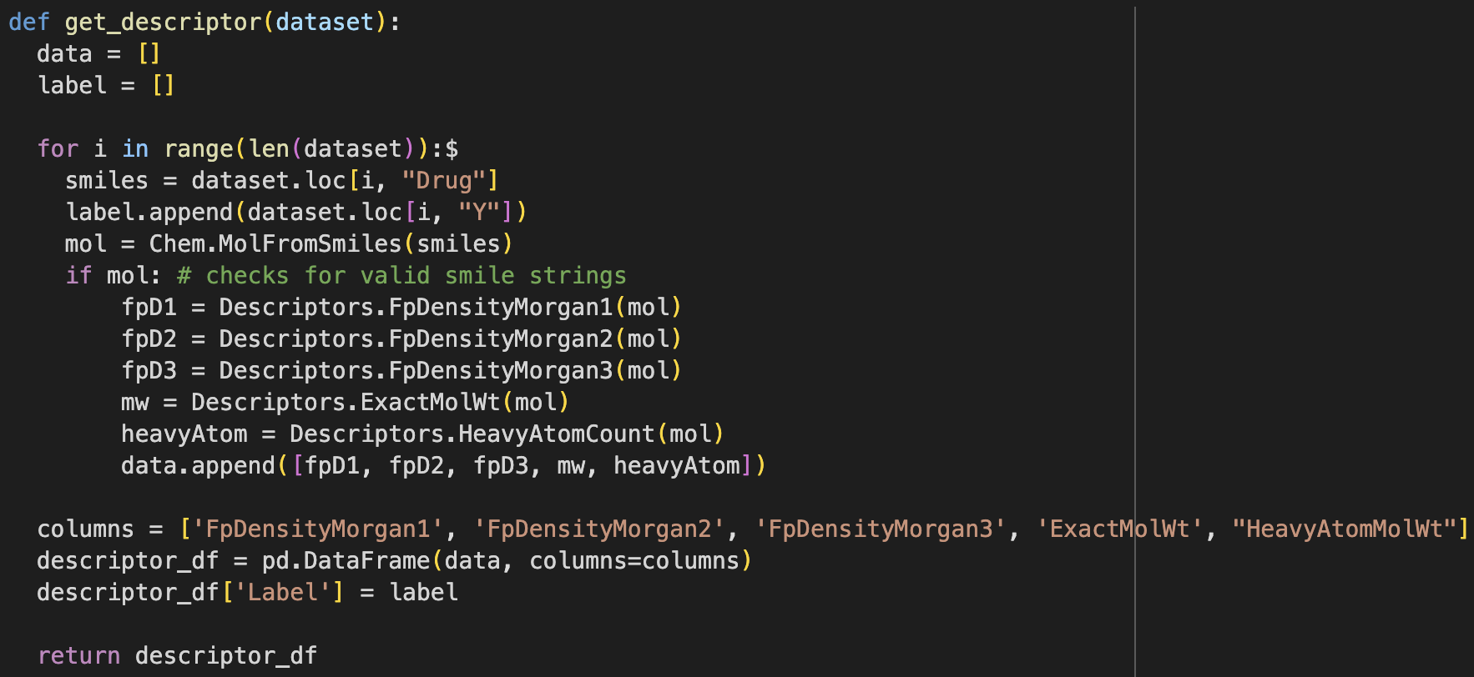
Feature Extraction with RD_Kit RFC
Create descriptor function with initialized data and label list.
Create a loop for the dataset, extracting smile strings and converting it to an interpretable molecular structure.
Columns and rows are created by using a pandas dataframe and returned after loop has iterated through all drugs.

Slide 9
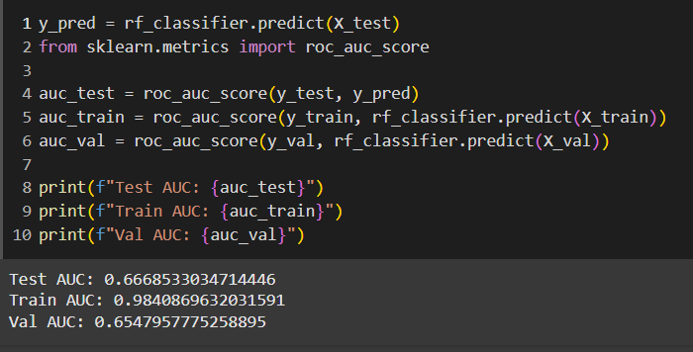
RD_Kit RFC
Fitting
Created a random forest classifier
Large forest
Assessment
Compute area under the receiver operating characteristic curve (ROC AUC)

Slide 10
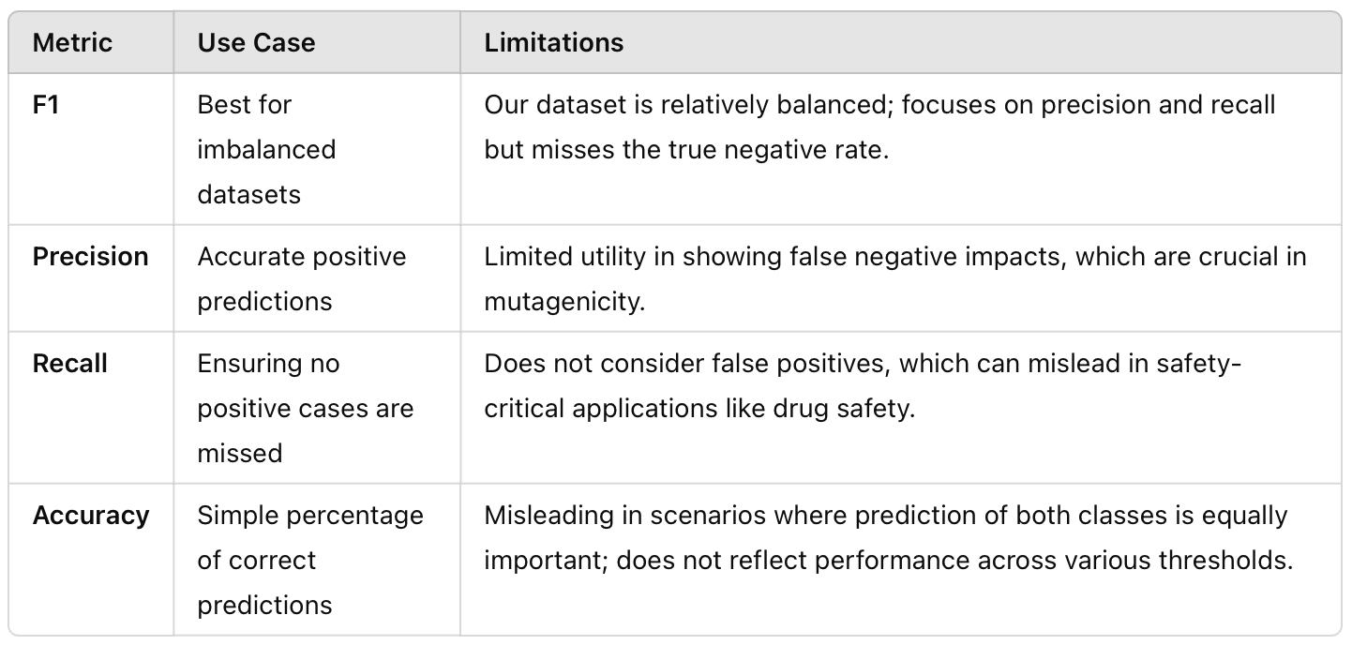
Why use ROC AUC
ROC AUC was chosen because:
1). It compares the relation between True Positive Rate (Sensitivity) and False Positive Rate (1 - Specificity) across different thresholds.
2). Effective for datasets with binary outcomes and models where distinguishing between classes is crucial.
3). Ideal for evaluating RFCs where class probabilities are used to make decisions.
Notes:
False positive: When a non mutagenic drug is predicted to be toxic

Slide 11
Feature Importance with RFC
Feature importance is calculated during the training phase. Utilization of the RFC built-in importance feature to determine which features contributes less to entropy across all trees.
Feature | Importance
Exact Molecular Weight | 0.358664
FpDensityMorgan3 | 0.201189
FpDensityMorgan1 | 0.178862
FpDensityMorgan2 | 0.158070
Heavy Atom Count | 0.103216

Slide 12
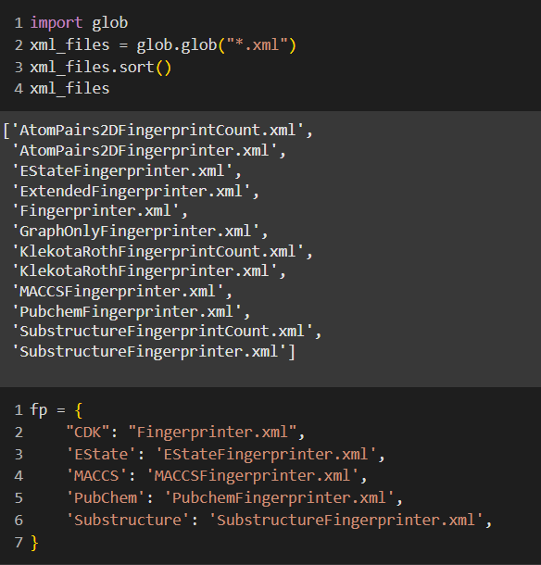
Padelpy: Fingerprints
Package to break down SMILE strings into fingerprints
Fingerprints provide important feature extraction
5 different fingerprints used by paper
CDK
EState
MACCS
PubChem
Substructure

Slide 13
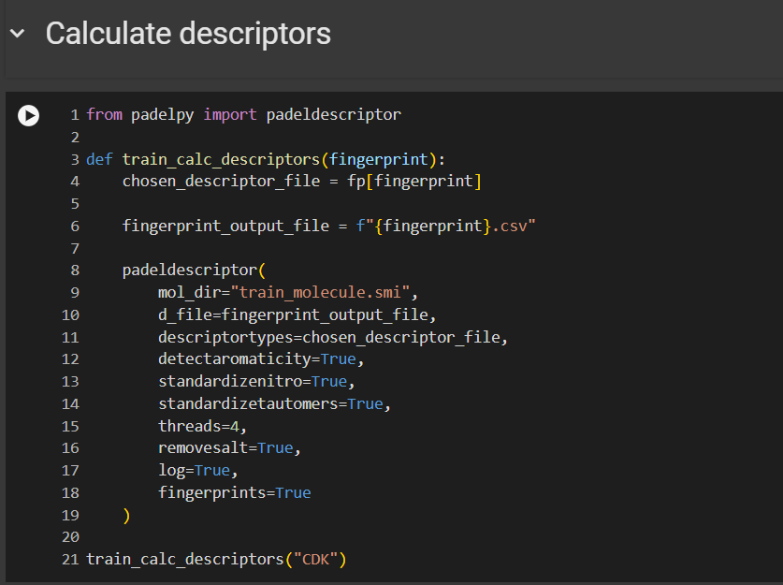
Padelpy: Fingerprints
Detect aromaticity: Enables detection of aromaticity (like benzene) in molecules
Standardized nitro: Enables detection of aromaticity (like -NO2) in molecules
Standardized tautomers: Standardizes molecules that can interconvert by rearranging bonds and atoms
Remove salt
Fingerprints = True:
Specifies that molecular fingerprints be calculated in addition to descriptors.

Slide 14
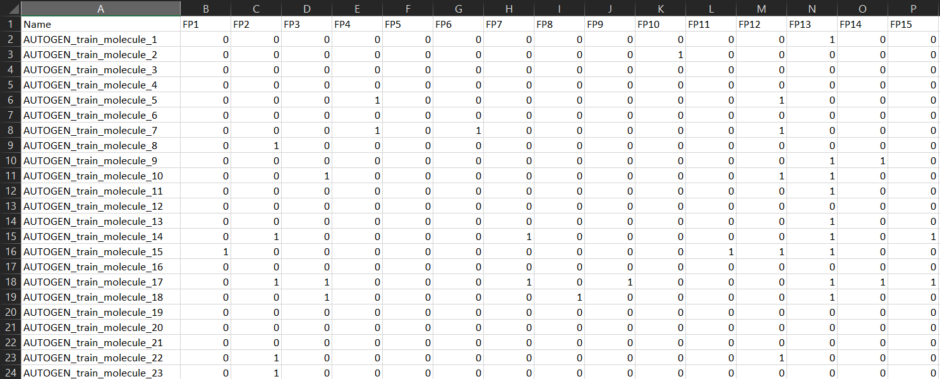
Padelpy: Fingerprints
1024 features from CDK fingerprint: train, validation, test
Java bash script breaks down smiles into fingerprints (features not easy to understand)

Slide 15
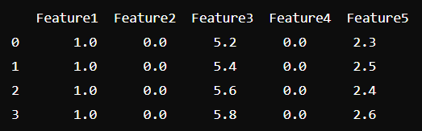
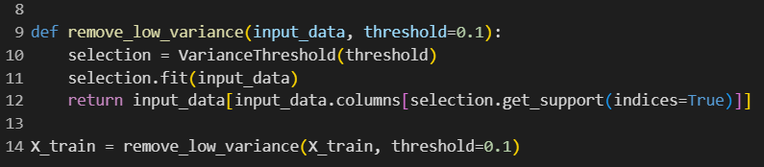
Padelpy: Removing low variance
Sample (not dataset)
Variance: 0 0 0.1 0 0.015
Removed variance lower than 0.1: 1024 -> 519 features for train

Slide 16
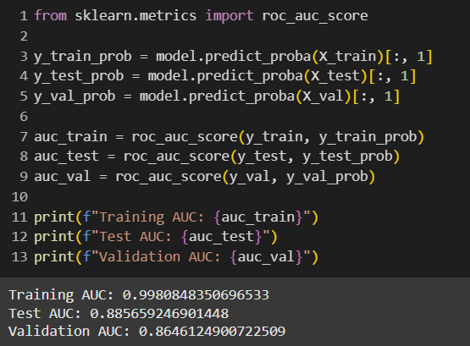
Padelpy RFC
0.881239812397 (I wish)

Slide 17
Feature Extraction Comparison
 | RD_Kit | Padelpy
Feature Number | 5 | 1024 -> 519
Feature Interpretability | High | Low
Feature Output | Numerical Weights | 0 or 1
Model Score ROC AUC | Training: 0.984 Test: 0.667 Val: 0.655 | Training: 0.998 Test: 0.886 Val: 0.865
RD_Kit offers high interpretability with fewer features, suitable for applications where understanding feature influence is crucial, but shows lower performance metrics.
Padelpy provides significantly better performance with less interpretability, making it ideal for applications prioritizing accuracy over transparency.

Slide 18
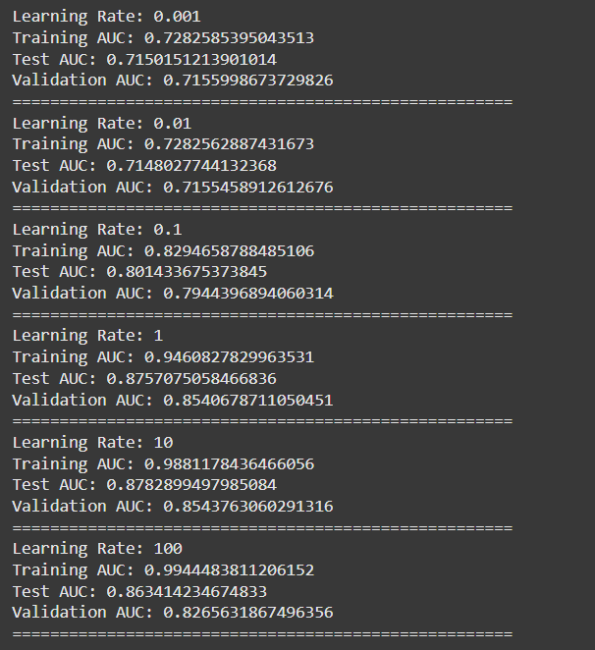
Padelpy SVM
kernel = ['linear', 'poly', 'rbf', 'sigmoid']
RBF was found to have the best output

Slide 19
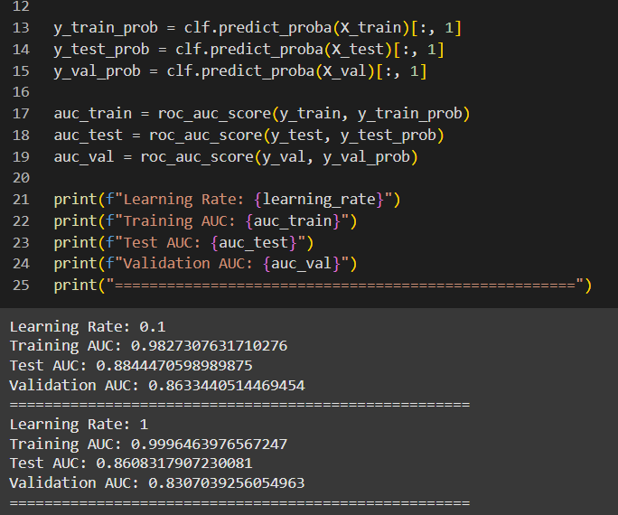
Padelpy XG Boost
Final Project CDD 203 Notes.pdf
PDF
Open file

Slide 20
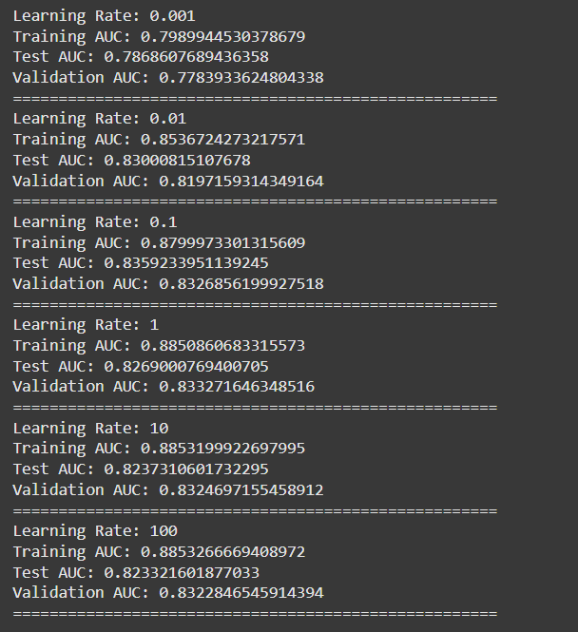
Padelpy Logistic Regression
L2 penalty applied for all learning rates

Slide 21
Model Evaluation
Model | Test ROC AUC Score | Train ROC AUC Score | Validation ROC AUC Score | Train - Val Score
SVM (PaDELpy) | 87.6% | 94.6% | 85.4% | 9.2%
Random Forest Classifier (PaDELpy) | 88.6% | 99.8% | 86.5% | 13.3%
XGBoost (PaDELpy) | 88.4% | 98.3% | 86.3% | 12%
Logistic Regression (PaDELpy) | 83.6% | 88.0% | 83.3% | 4.7%
Random Forest Classifier (RDKit) | 66.7% | 98.4% | 65.5% | 32.9%

Slide 22
AMES Mutagenicity Paper Results
Model | Validation | External Validation
MACCS-kNN | 0.824 | 0.956
PubChem-kNN | 0.824 | 0.970
FP-SVM | 0.844 | 0.903
MACCS-SVM | 0.853 | 0.924
PubChem-SVM | 0.853 | 0.949
Xu Chemical Information and Modeling 2012

Slide 23
Summary
Constructed random forest classifier based model to determine the mutagenicity of a molecule based on capture of overall structure, heavy atoms, and molecular weight by use of RDKit and PADELPy.
Alternatively, PADELPy, a molecular descriptor calculation software, was also utilized and evaluated with RFC, support vector machine (SVM), XGBoost, and logistic regression.
SVM recorded the best measure for the test AUC. See how they compared:
RFC Test AUC = 0.67
Log Regression Test AUC = 0.84 (lr = 0.1)
XGBoost Test AUC = 0.88 (lr = 0.1)
SVM Test AUC = 0.88 (lr = 1)
RFC Test AUC = 0.89
RDKit
PADELPy
PADELPy
PADELPy
PADELPy

Slide 24
Future Work
Understanding the overfitting
Getting better test + val scores
Reduce running time (~30 mins for all models to run in Colab)
Big-O Notation complexity assessment
External validation

Slide 25


Q&A

Slide 26
Model Links
RDkit RFC: https://colab.research.google.com/drive/141Ps68ZjL6I4zw55dOnDVr_HfP3I2p5E?usp=sharing
PaDELpy Models:
https://colab.research.google.com/drive/1KoVn-JsbcoWV4OO_BzQc0h7DVyCsVwM-#scrollTo=PToFnUuN07fe
Paper:
https://pubs.acs.org/doi/full/10.1021/ci300400a?casa_token=A86ksblef0kAAAAA%3A2kLxP4j2NOigeBsSqUb8C9ThZLVBR_%20%20%20%20%20%20%20%20%20%20%20%20%20%20%20%20%20%20%20%20Ztc8gJg_HhyLCRtZF-MfMMyq4bIwhMlH0MyJXZuWkFXXrGqiMR

